Slide 1
PROJECT 2 : RBF SOLUTION
VENKATA KRISHNA KARTHIK BURRA
16230698

Slide 2
RBF NEURAL NETS (Tr-60%, val-20%, T-20%) MATLAB CODE
load('P.mat');
load('T.mat');
[trainP,valP,testP,trainInd,valInd,testInd]=dividerand(P,0.6,0.2,0.2);
[trainT,valT,testT]=divideind(T,trainInd,valInd,testInd);
GOAL=0.5;
for SPREAD1=10:2:100;
net1=newrbe(trainP,trainT,SPREAD1);
y1v=sim(net1,valP);
mse1v=mse(y1v-valT);
if (mse1v <= 0.5)
display(SPREAD1)
display(mse1v)
break
end
end

Slide 3
for SPREAD2=10:2:100;
net2=newrb(trainP,trainT,GOAL,SPREAD2);
y2v=sim(net2,valP);
mse2v=mse(y2v-valT);
if (mse2v <= 0.5)
display(SPREAD2)
display(mse2v)
break
end
end
y1v= sim(net1,valP);
y1Tr= sim(net1,trainP);
y1T=sim(net1,testP);
c=cm(y1v,valT);
c1=cm(y1Tr,trainT);
c2=cm(y1T,testT);
y2v=sim(net2,valP);
y2Tr=sim(net2,trainP);
y2T=sim(net2,testP);
c3=cm(y2v,valT);
c4=cm(y2Tr,trainT);
c5=cm(y2T,testT);
roc= ezroc3((y2Tr+1)/2,(trainT+1)/2,2,'ROC',1);

Slide 4
function [c]=cm(pc,tc)
for i=1:length(pc)
if (pc(i)>=0);
pc(i)=1;
else
pc(i)=-1;
end;
end;
TP=0; FN=0; FP=0; TN=0;
for i=1:length(pc)
if(tc(i)==1 && pc(i)==1)
TP=TP+1;
elseif(tc(i)==1&&pc(i)==-1)
FP=FP+1;
elseif(tc(i)==-1&&pc(i)==1)
FN=FN+1;
elseif(tc(i)==-1&&pc(i)==-1)
TN=TN+1;
end;
end;
FAR = FP/(TN+FP);
FRR = FN/(TP+FN);
GAR = TP/(TP+FN);
GRR = TN/(TN+FP);
c=[GAR,FAR; FRR,GRR];

Slide 5
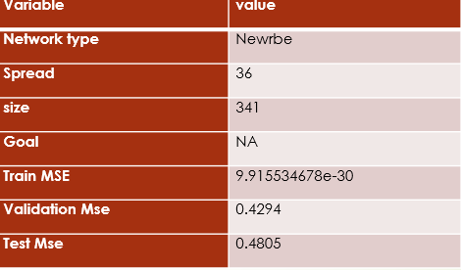
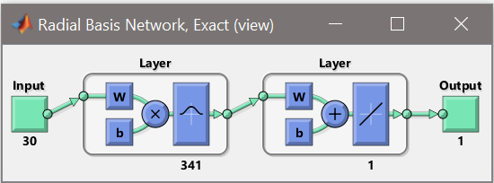
TASK1
NEWRBE network
Observations: I could see training mse is very less and we have set to train network to achieve validation mse of 0.5 and I could see testing mse is also less than training mse.

Slide 6
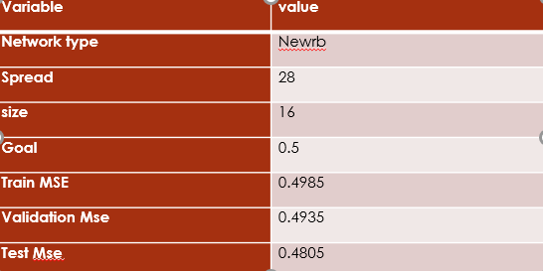
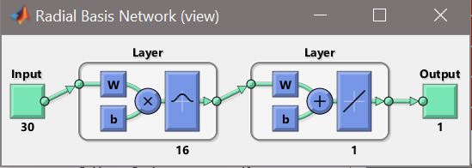
NEWRB network
Observations: I have set goal value as 0.5 so as to achieve a validation mse of 0.4935 ( closest to 0.5). But, the test mse is still less than train mse.

Slide 7
TEST MSE OF FINAL SOLUTION
NEWRBE (NET1)
SPREAD1=36
MSE1T=0.4805
NEWRB (NET2)
SPREAD2=28
MSE2T=0.4805

Slide 8
GENERATING CONFUSION MATRICES
Net1
Validation
c= 0.8537 0.0545
0.1463 0.9452
Train
c1= 0.9420 0.0148
0.0580 0.9852
Test
c2= 0.9697 0.0370
0.0303 0.9630

Slide 9
Net2
Validation
c3= 0.7222 0
0.2778 1
Train
c4= 0.75710 0.0068
0.2429 0.9932
Test
c2= 0.5441 0.0217
0.4559 0.9783
Conclusion:
Using a for loop and to find mse of validation set less than 0.5 we got values of spread of 36 for net 1 and 28 for net 2 . Also the value of confusion matrices have been found out for validation, train and test sets for net1 and net2. For confusion matrix of validation for net2 FAR=0 which means False Positive is zero and the network didn’t classify 1 as -1

Slide 10
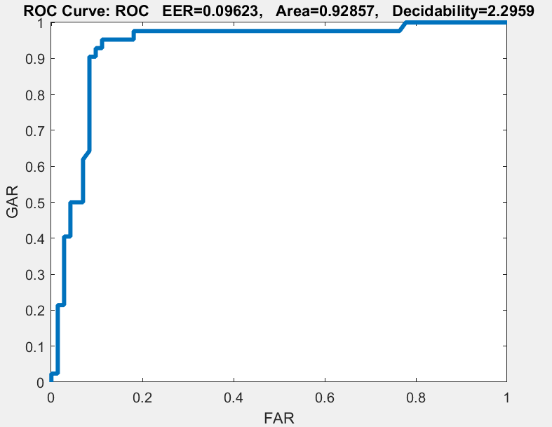
TASK2 – PLOTTING ROC
Validation ROC Plot for net1

Slide 11
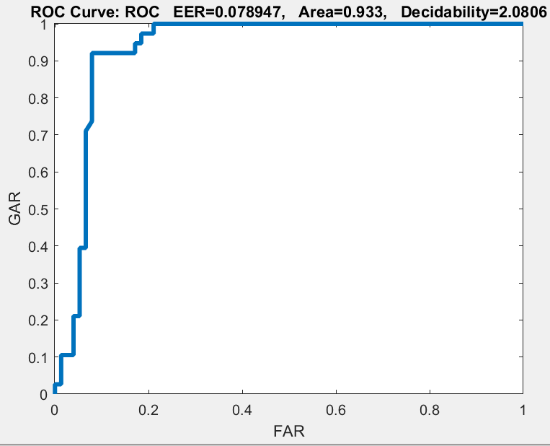
Validation ROC plot for net 2

Slide 12
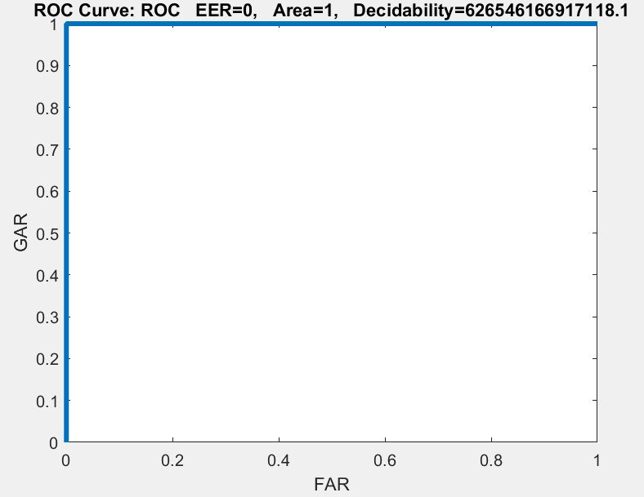
Train ROC plot for net1

Slide 13
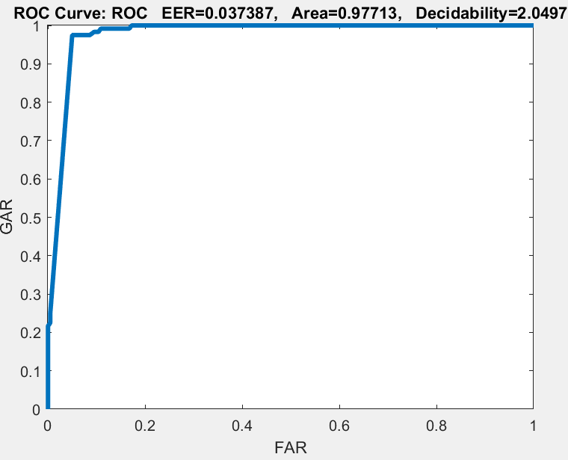
Train ROC plot for net2

Slide 14
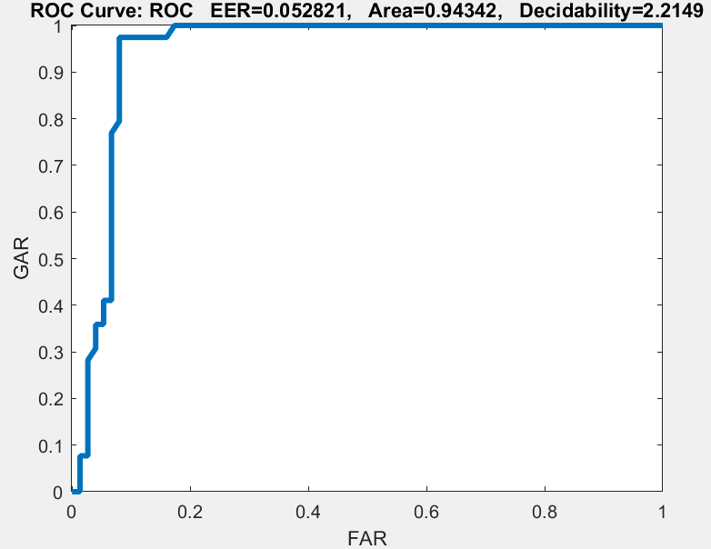
Test ROC plot for net1

Slide 15
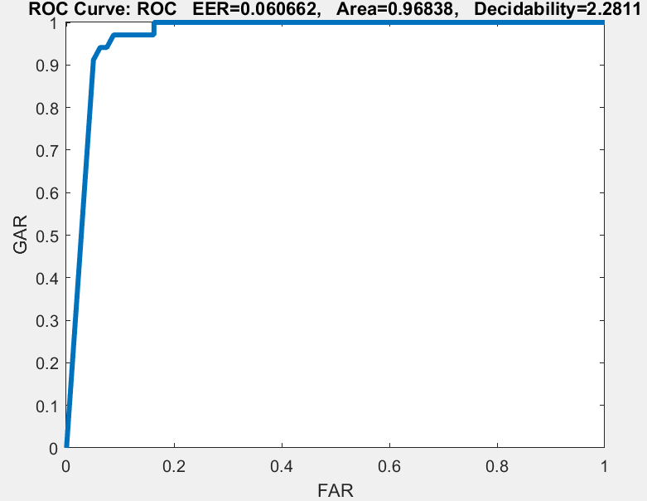
Test ROC plot for net2

Slide 16
ROC was calculated and plotted for train, validation and test sets for net1 and net2 .The plots can be done by using ezroc3 function. The target and output values were made 1’s and 0’s for plotting the roc curve.

